Slide 1
Single cell genomics!
Cedric Notredame, adapted from Serena Liu

Slide 3
Why single cell?
Bulk
Measures average gene expression levels across a population of cells
Useful for quantifying gene expression in homogeneous populations
Cheaper, easier, and more straightforward to analyze
Single cell
Measures the distribution of gene expression levels across a population of cells
Useful for studying cell-specific transcriptomic differences in heterogeneous populations
More difficult to collect and analyze, but allows us to study new questions

Slide 4
Applications of single-cell RNA-seq
Identifying rare cell subtypes
Mahata et al. (2014)
Shalek et al. (2014)
“If you compare the brain to a fruit salad, you could say that previous methods were like running the fruit through a blender and seeing what colour juice you got from different parts of the brain…[Single-cell RNA-seq] is like taking pieces of the fruit salad, examining them one by one and then sorting them into piles to see how many different kinds of fruit it contains, what they’re made up of and how they interrelate.” – Sten Linnarsson
Sandberg, R. (2013). Entering the era of single-cell transcriptomics in biology and medicine. Nat. Methods 11, 22-24.
Notes:
Mahata et al. (2014): identify subpopulation of Th2 cells that produce the steroid pregnenolone → suppresses T-cell proliferation, and thus helps maintain homeostasis
Shalek et al. (2014): identify bone marrow DCs that are early responders to LPS induced inflammatory signals

Slide 5
Applications of single-cell RNA-seq
Identifying rare cell subtypes
Mahata et al. (2014)
Shalek et al. (2014)
Trace lineage/developmental relationships between cell states
Treutlein et al. (2014)
Cao et al. (2017)
Measure stochasticity of gene expression
Meredith et al. (2015)
Sandberg, R. (2013). Entering the era of single-cell transcriptomics in biology and medicine. Nat. Methods 11, 22-24.
Notes:
Treutlein et al. (2014): reconstructed lineage hierarchies of distal lung epithelium from single cell data
Cao et al. (2014): single cell data from whole worm → resolves to separate tissues and cell types; different neuron types were resolved, even down to neurons with copy number of 1-2

Slide 10
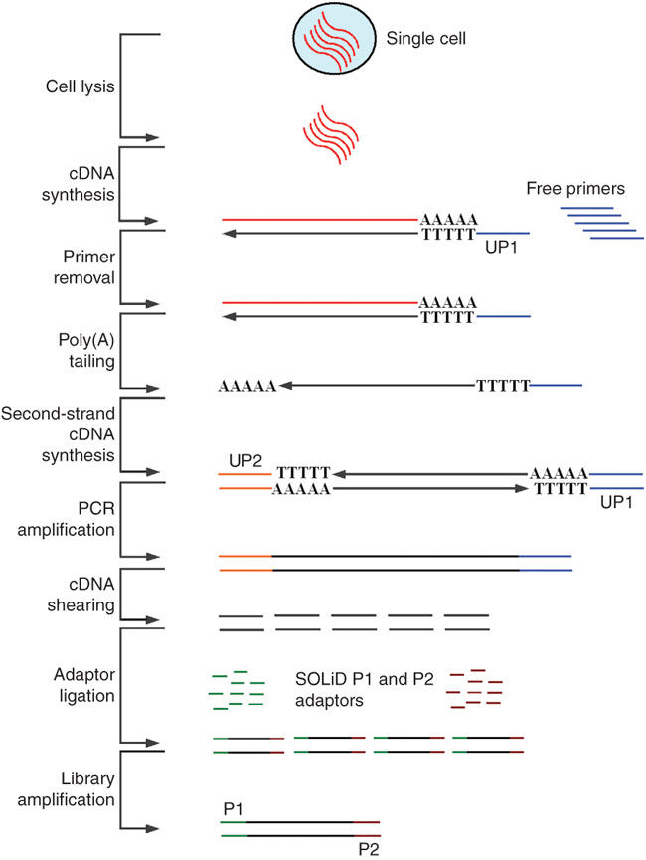
Brief history of single cell RNA-seq
2009: Tang et al. collect RNA-seq data from manually isolated single mouse blastomeres
2012: Hashimshony et al. CEL-seq incorporates multiplexed linear amplification to increase sensitivity
2012: Fluidigm C1 introduces a commercial platform for single cell RNA-seq
2014: Jaitin et al. use FACS and automated processing to increase throughput and reproducibility
2015: Klein et al. (inDrop) and Macosko et al. (Drop-seq) isolate single cells in droplets
2016: 10x Chromium platform for droplet-based single-cell RNA-seq
2017: Cao et al. (sciRNA-seq) combinatorial indexing to virtually compartmentalize single cells
Tang et al. (2009)
Notes:
Tang et al. blastomeres were from the 4-cell stage
Fluidigm: integrated fluidic circuit to capture cells

Slide 11
Typical single cell experimental workflow

Slide 12
How are single cells isolated?
Gross et al. (2015). Technologies for Single-Cell Isolation. Int. J. Mol. Sci. 16(8) 16897-919.
Notes:
LCM: laser capture microdissection

Slide 13
How are single cells isolated?
Cao et al. (2017). Comprehensive single-cell transcriptional profiling of a multicellular organism. Science 357(6352) 661-67.
Notes:
LCM: laser capture microdissection

Slide 14
How are single cells isolated?
Klein et al. (2015). Droplet Barcoding for Single-Cell Transcriptomics Applied to Embryonic Stem Cells. Cell 161(5) 1187-201.
Notes:
LCM: laser capture microdissection

Slide 15
How are single cells isolated?
10x Genomics, https://www.10xgenomics.com/solutions/single-cell/
Notes:
LCM: laser capture microdissection

Slide 16
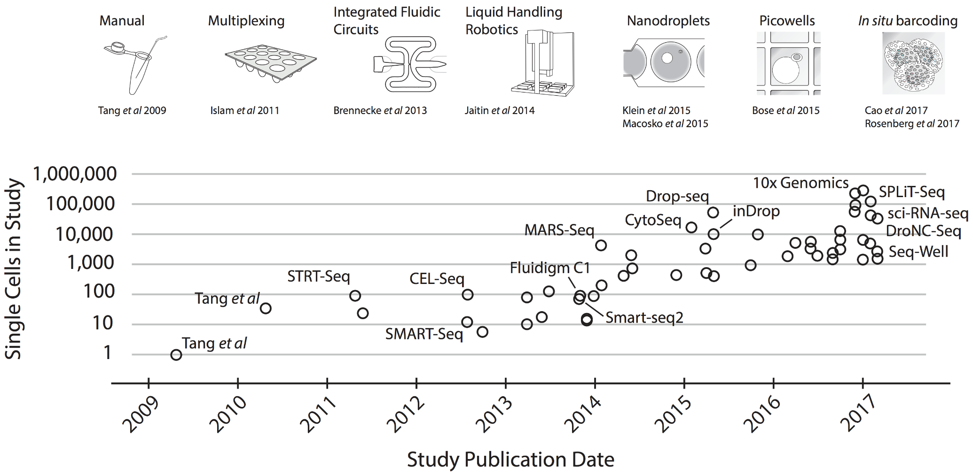
Evolution of single cell methodologies
Svensson et al. (2017). Exponential scaling of single-cell RNA-seq in the last decade. arXiv:1704.01379v2

Slide 17
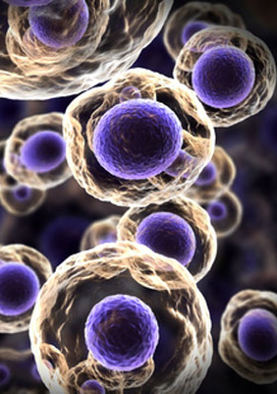
Which platform to use?
Input requirements
Minimum number of cells needed?
Cell conditions (fresh vs. fixed)?
Experimental design
Number of samples to collect?
Number of cells needed per sample?
Controlling for batch effects?
Cost/availability

Slide 18
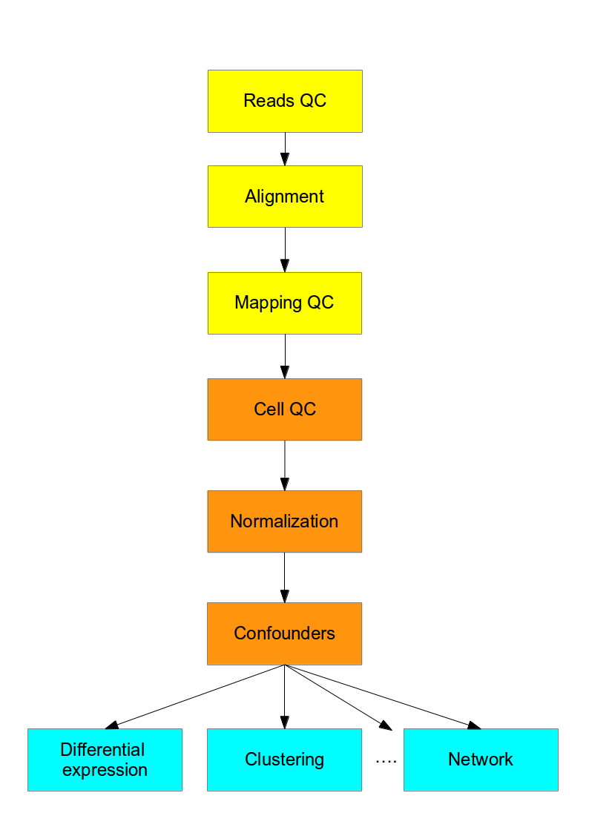
Computational workflow
~400K mRNA transcripts in a mammalian cell → 500k-5M reads per cell
Typically sequence up to 80-90% duplication
Quantitative controls
ERCC spike-ins (92 synthetic spikes, based on bacterial sequences)
Unique Molecular Identifiers (UMIs)
Stegle et al. (2015)

Slide 19
Computational workflow
Read quality, alignment, mapping → can use the same metrics as for bulk RNA-seq data
Cell quality → want to filter out cells with degraded RNA, doublets, “cells” of free-floating RNA
Normalization of read counts
FPKM implicitly assumes similar total amount of RNA processed per sample
ERCC and/or UMI-based normalization
Stegle et al. (2015)

Slide 20
Challenges of single-cell data
Gene dropout
mRNA capture rate ~65%
Zero-inflated distributions
Confounding effects (cell cycle, apoptosis, etc.)
Latent-variable models to correct for confounding variation
High variability
Distinguishing between biological and technical variation
Stegle et al. (2015). Computational and analytical challenges in single cell transcriptomics. Nat. Rev. Genetics 16, 133-45.

Slide 21
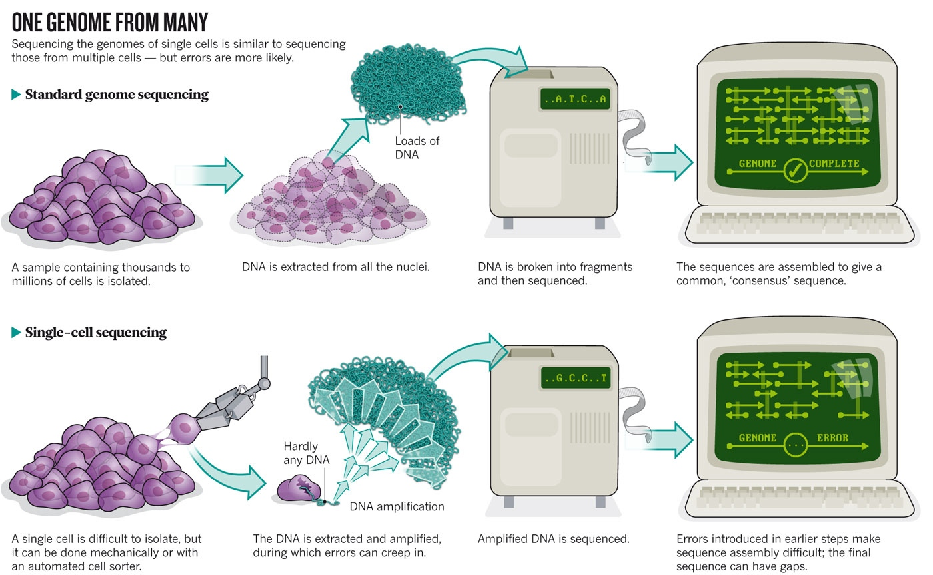
Owens, Brian. (2012). Genomics: The single life. Nature 491, 27-29.

Slide 22
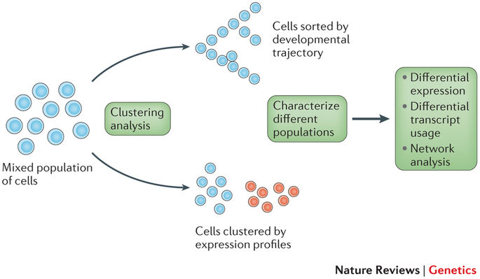
Downstream analysis
Stegle et al. (2015). Computational and analytical challenges in single cell transcriptomics. Nat. Rev. Genetics 16, 133-45.
Notes:
This is where biological interpretations/new insights come in!
Both clustering and trajectory analyses will typically be combined with a dimensionality reduction technique
Combine prior biological knowledge (e.g. markers for cell types) with the patterns observed in the groupings of single cells to draw new inferences

Slide 24
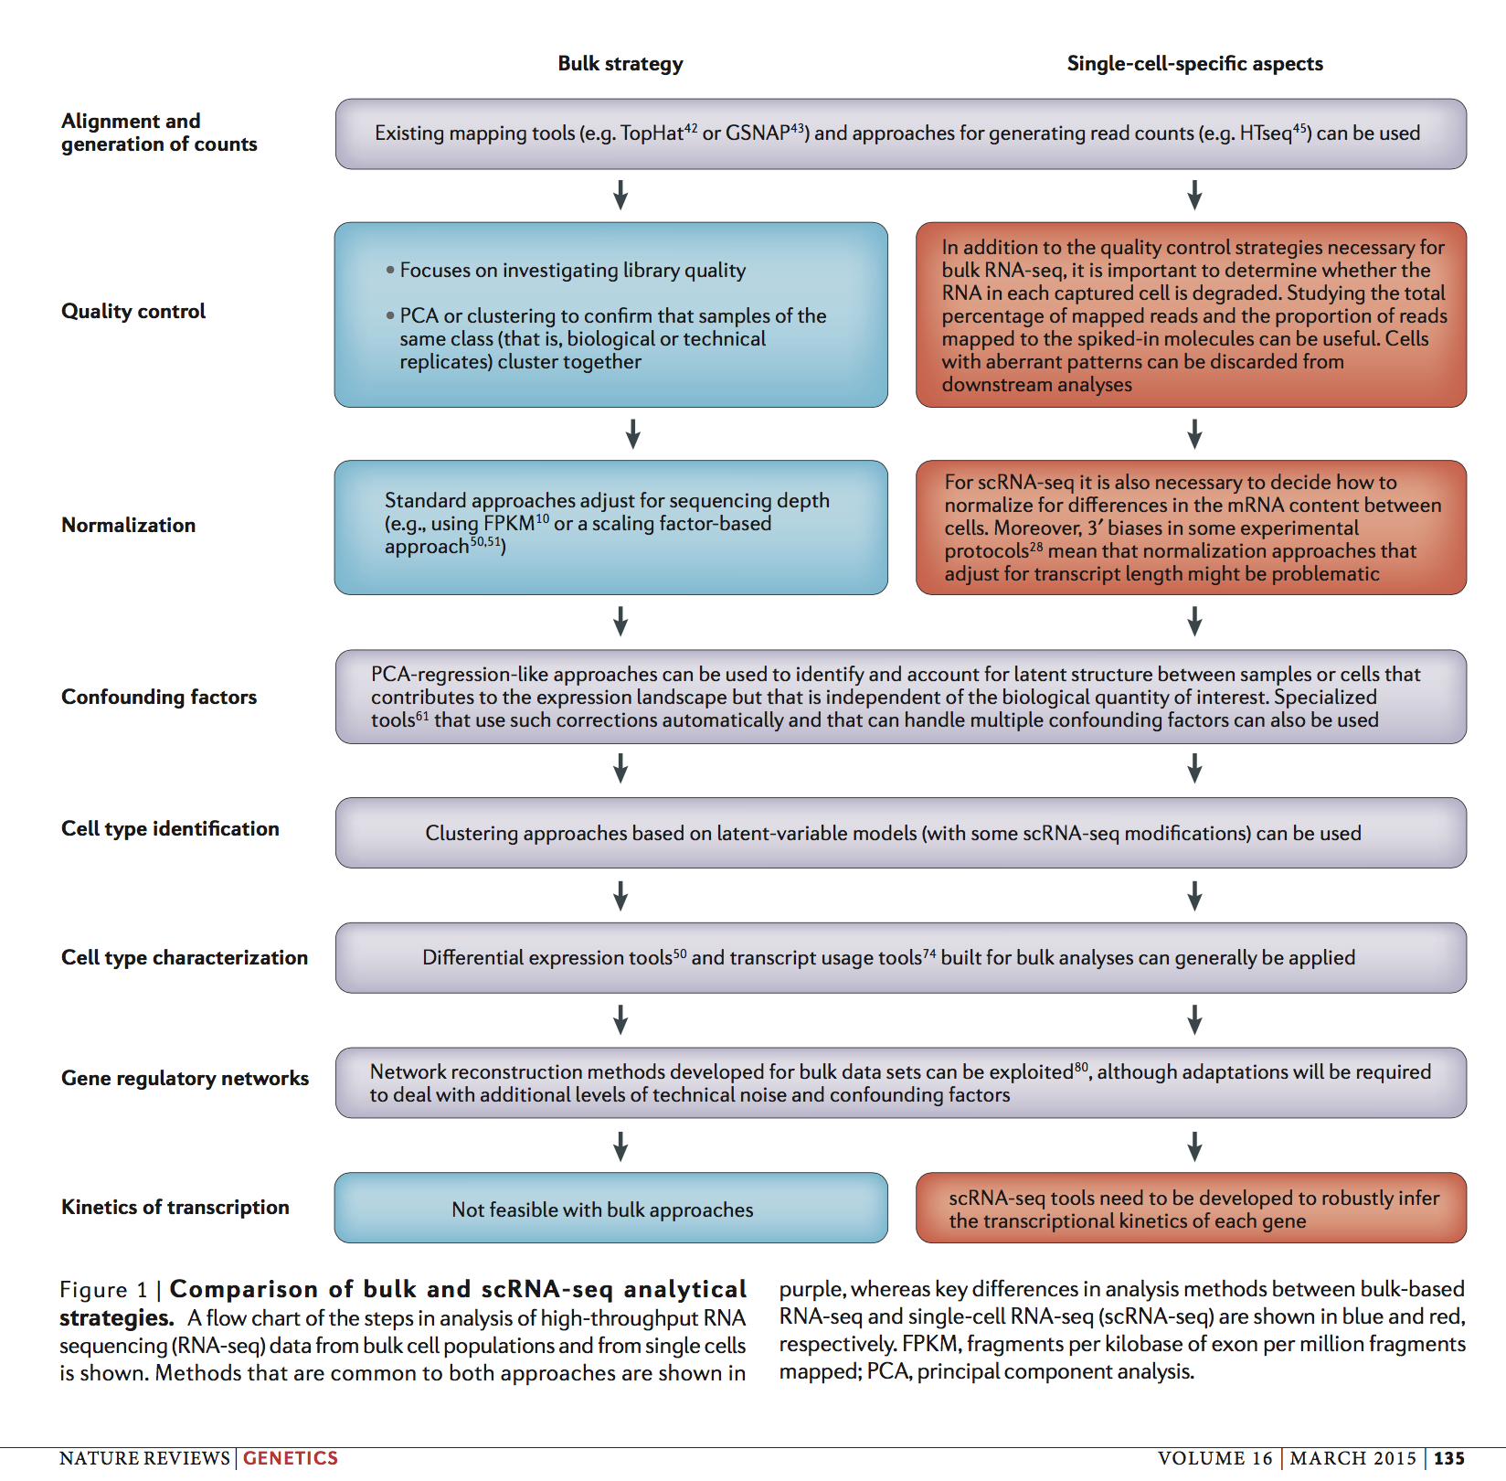

Slide 26
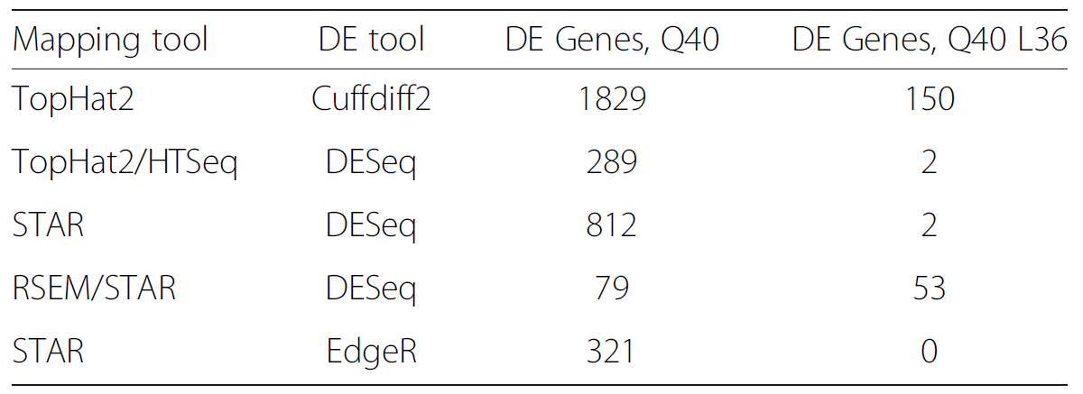
Reads QC
Read mapping
Normalization
Quantification
Clustering
Cells QC
Differential expression
Functional analysis
Trimming parameters can significantly change results!
Williams et al. 2016, https://bmcbioinformatics.biomedcentral.com/articles/10.1186/s12859-016-0956-2

Slide 27
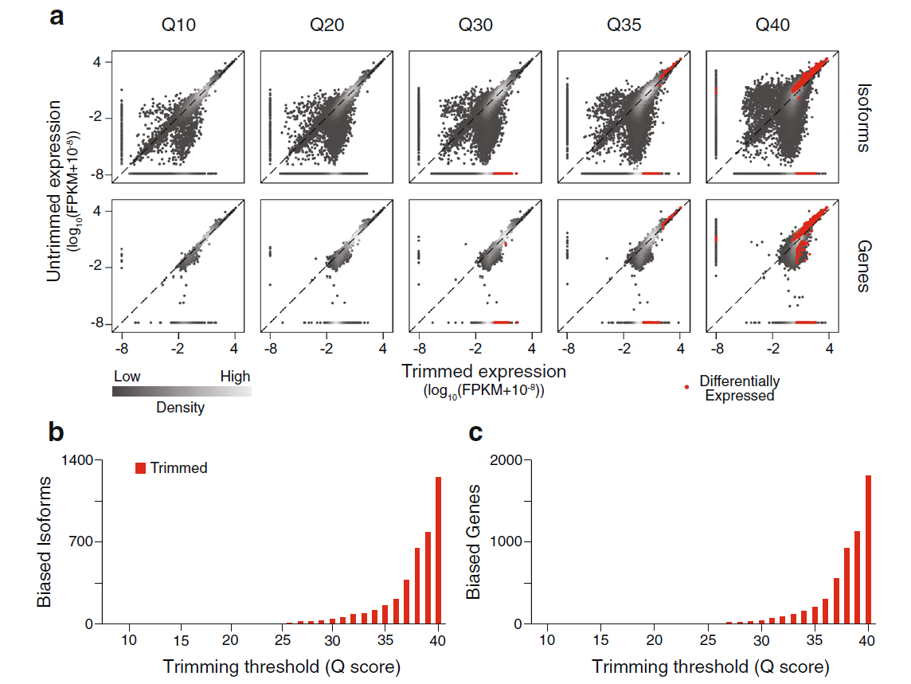
Reads QC
Read mapping
Normalization
Quantification
Clustering
Cells QC
Differential expression
Functional analysis
Trimming parameters can significantly change results!
Williams et al. 2016, https://bmcbioinformatics.biomedcentral.com/articles/10.1186/s12859-016-0956-2

Slide 28
Reads QC
Read mapping
Normalization
Quantification
Clustering
Cells QC
Differential expression
Functional analysis
RNA-Seq read mapping strategies:
Ungapped mapping (with mismatches) to genome
Cannot align reads spanning exon-junctions
Local alignment (Smith-Waterman) to genome
Very slow
Spliced alignment to genome
Computationally harder than ungapped alignment, but much faster than local alignment
Mapping on transcript libraries
Fastest, but cannot align reads from un-annotated transcripts
Mapping on exon-exon junction libraries
Cannot align reads overlapping un-annotated exons
Hybrid approaches

Slide 29
Reads QC
Read mapping
Normalization
Quantification
Clustering
Cells QC
Differential expression
Functional analysis
Cannot use raw read counts
Islam et al. http://www.nature.com/nmeth/journal/v11/n2/full/nmeth.2772.html

Slide 30
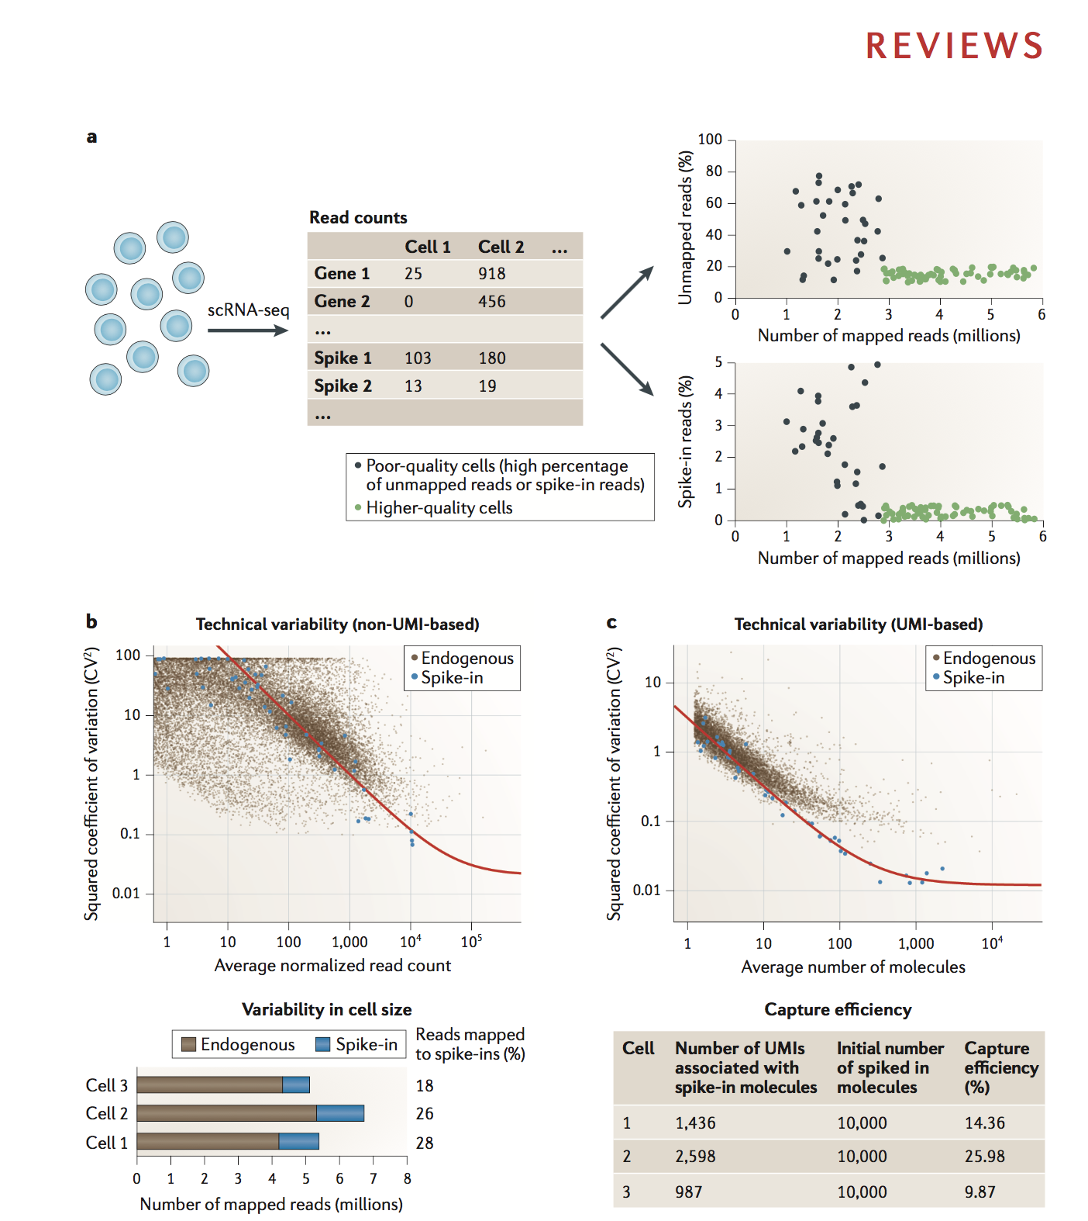
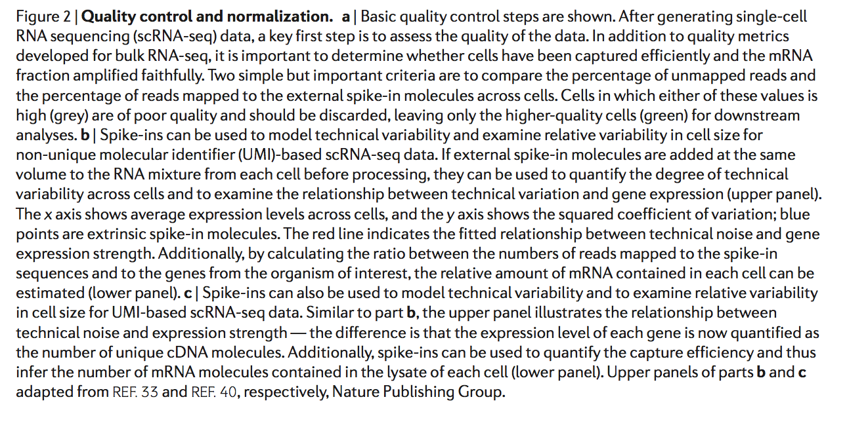

Slide 31
Reads QC
Read mapping
Normalization
Quantification
Clustering
Cells QC
Differential expression
Functional analysis
CPM = count per million
Ignores multireads ➔ underestimates expression of genes in large families
Does not normalize for gene length ➔ cannot compare CPMs b/w genes
Comparing CPMs between samples assumes similar transcriptome size
RPKM/FPKM = reads/fragments per kilobase per million
[Mortazavi et al. 08] Fractionally allocates multireads based on unique read estimates
Length for multi-isoform genes?
Comparing FPKM between samples assumes similar transcriptome size
TPM: transcripts per million
Still relative measure of expression, but comparable between samples
Most accurate estimation methods allocate multireads via expectation-maximization
UMI counts
Absolute measure of expression?

Slide 32
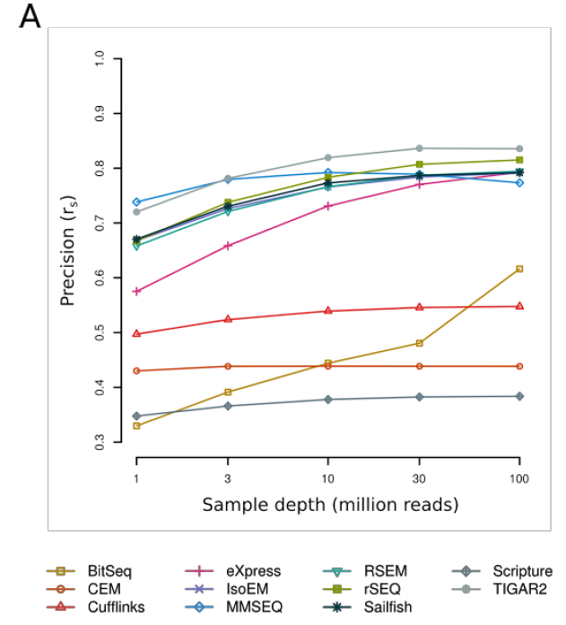
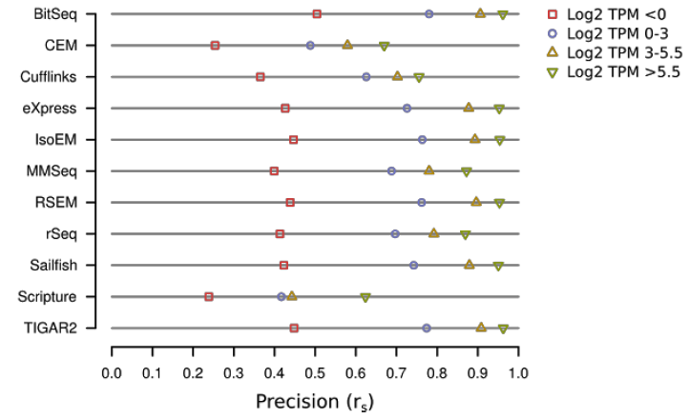
Accuracy comparison (Kanitz et al. 2015)
Reads QC
Read mapping
Normalization
Quantification
Clustering
Cells QC
Differential expression
Functional analysis
30M reads

Slide 33
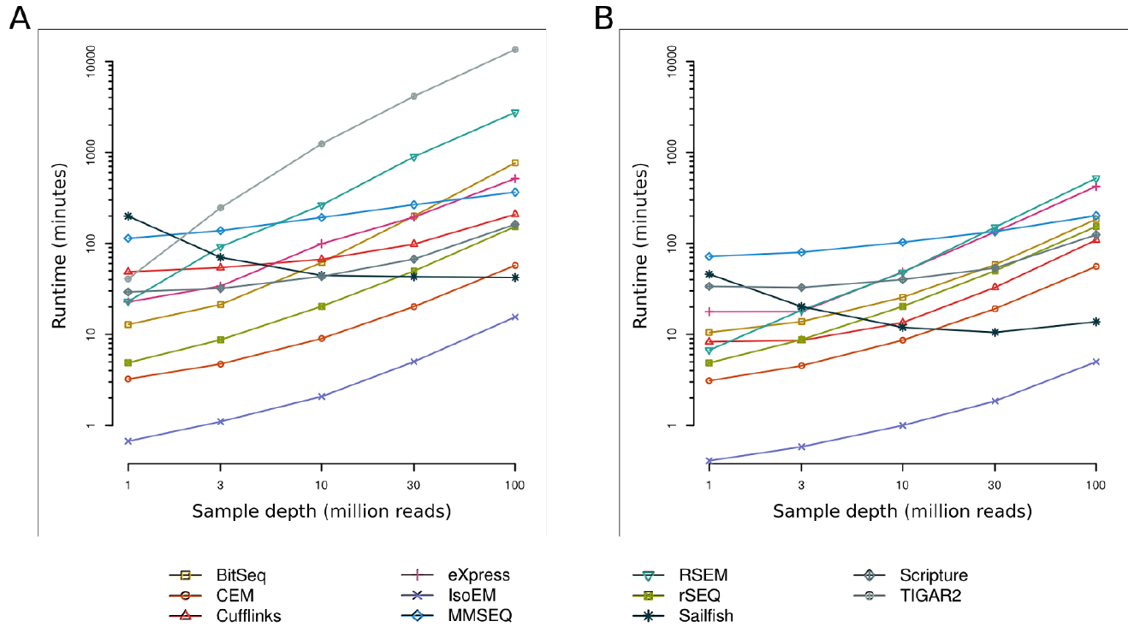
Reads QC
Read mapping
Normalization
Quantification
Clustering
Cells QC
Differential expression
Functional analysis
Runtime comparison (Kanitz et al. 2015)
1 core
16 cores

Slide 34
Reads QC
Read mapping
Normalization
Quantification
Clustering
Cells QC
Differential expression
Functional analysis
Why speed matters?
Quantifying estimate uncertainty by non-parametric bootstrapping
TPM_{RPG}
TPM_{RPG}
M reads
M reads
TPM_{RPG}
M reads

Slide 35
Reads QC
Read mapping
Normalization
Quantification
Clustering
Cells QC
Differential expression
Functional analysis
Detected genes/cell -- main population
Detected genes/cell -- bi-modal distribution
Detected genes/cell -- minor population

Slide 36
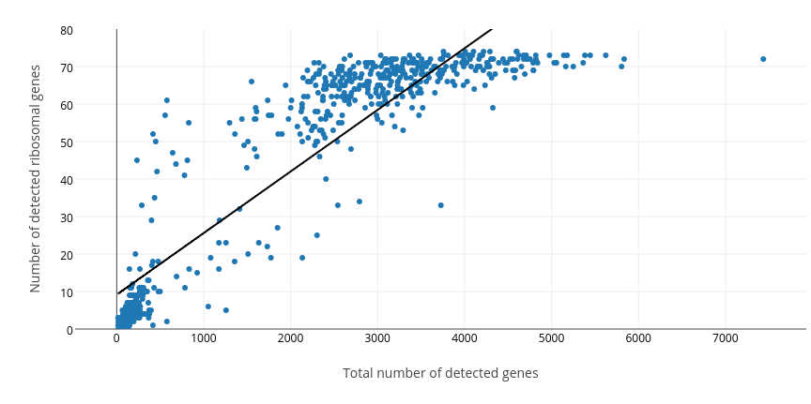
Reads QC
Read mapping
Normalization
Quantification
Clustering
Cells QC
Differential expression
Functional analysis
Technical failures or biologically interesting cells?

Slide 37
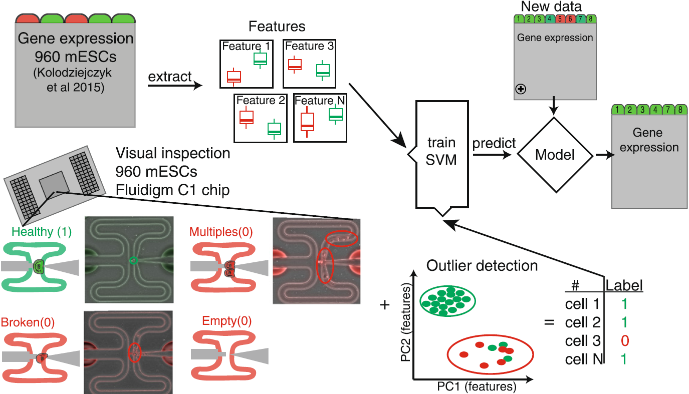
Reads QC
Read mapping
Normalization
Quantification
Clustering
Cells QC
Differential expression
Functional analysis
Cellity cell-QC pipeline
Ilicic et al. 2016, https://genomebiology.biomedcentral.com/articles/10.1186/s13059-016-0888-1

Slide 38
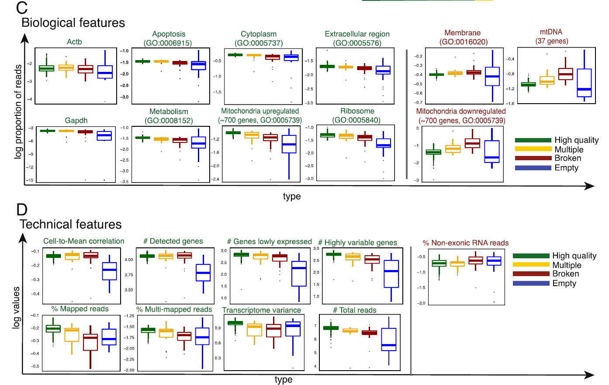
Reads QC
Read mapping
Normalization
Quantification
Clustering
Cells QC
Differential expression
Functional analysis
Cellity cell-QC pipeline
Ilicic et al. 2016, https://genomebiology.biomedcentral.com/articles/10.1186/s13059-016-0888-1

Slide 39
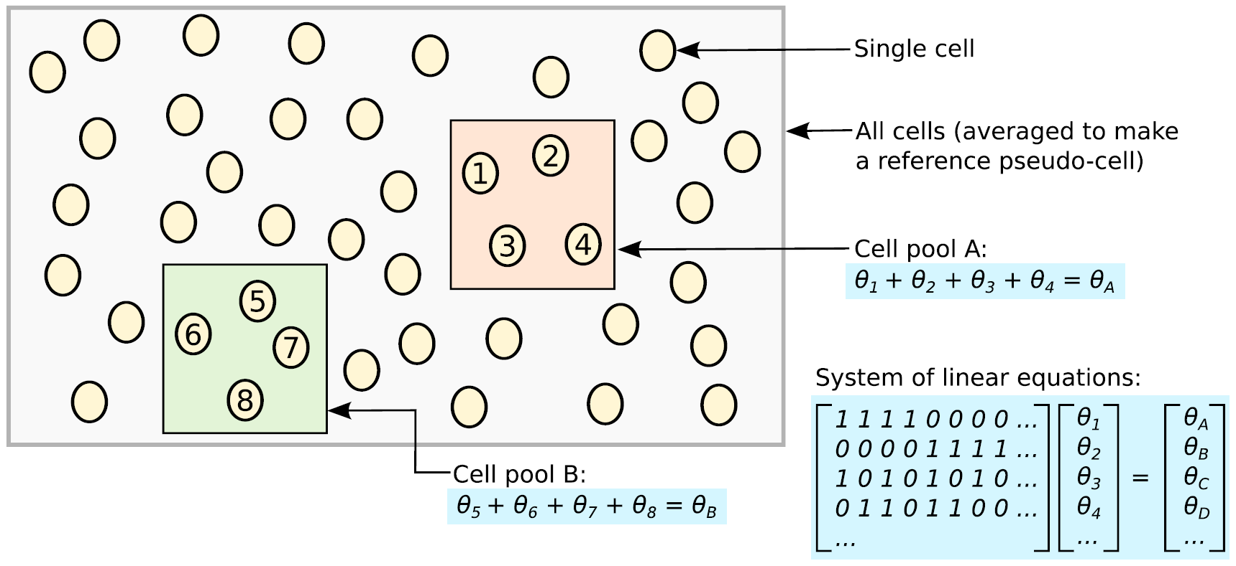
Reads QC
Read mapping
Normalization
Quantification
Clustering
Cells QC
Differential expression
Functional analysis
Need to correct for variability in RT & amplification efficiency, sequencing depth, batch effects, …
Based on external controls (ERCC)
Based on expression levels/counts (DESeq, TMM, pool-based deconvolution)

Slide 40
Many clustering algorithms!
Reads QC
Read mapping
Normalization
Quantification
Clustering
Cells QC
Differential expression
Functional analysis
Algorithm | Parameters
K-means | K = Number of clusters
Fuzzy c-means Clustering (FCM) | K = number of clusters d = Degree of fuzziness
Hierarchical Clustering (HCS) | Metric = euclidean, seuclidean, cityblock, minkowski, chebychev, cosine, correlation, spearman Method = average, centroid, complete, median, single
EM Clustering | K = Number of clusters S = Number of initial seeds I = Number of iteration
SNN-Cliq | n = Size of the nearest neighbor list r = Density threshold of quasi-cliques m = Threshold on the overlapping rate for merging.

Slide 41
Accuracy measures
Reads QC
Read mapping
Normalization
Quantification
Clustering
Cells QC
Differential expression
Functional analysis
Purity | U: set of ground truth classes; V: set of the computed clusters; N:total # of objects in dataset
Rand Index (RI) | RI= (TP+TN)/(TP+FP+FN+TN)
F1 Score | F1 Score= 2×TP/(2×TP+FP+FN)
Corr | Maximum weighted Pearson correlation between average expression value of each class at ground truth and computed cluster
Hubert’s index (HI) | HI = RI – MI
Mirkin’s index (MI) | It counts the number of disagreements in data pairs between two clustering. It is the ratio of the number of disagreeing pairs to the total number of pairs. Lower value of Mirkin’s index indicates better clustering.

Slide 42
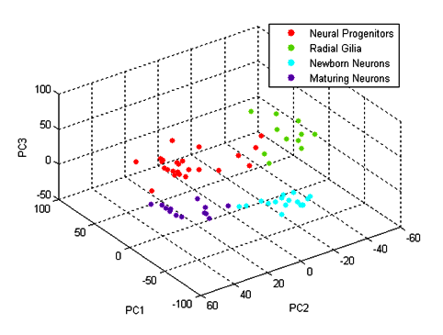
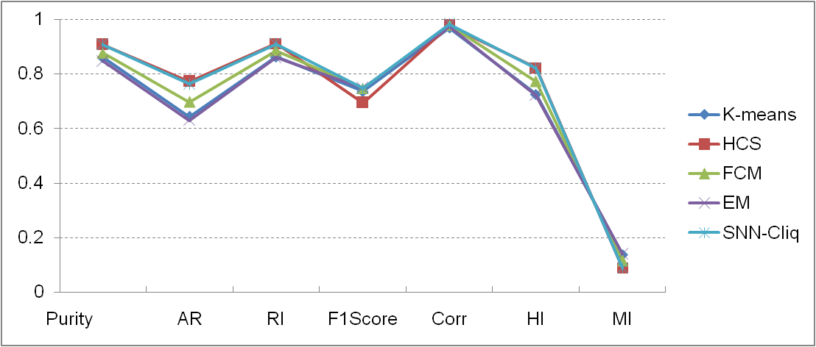
Accuracy comparison (Pollen et al. 2014, HiSeq)
Reads QC
Read mapping
Normalization
Quantification
Clustering
Cells QC
Differential expression
Functional analysis

Slide 50
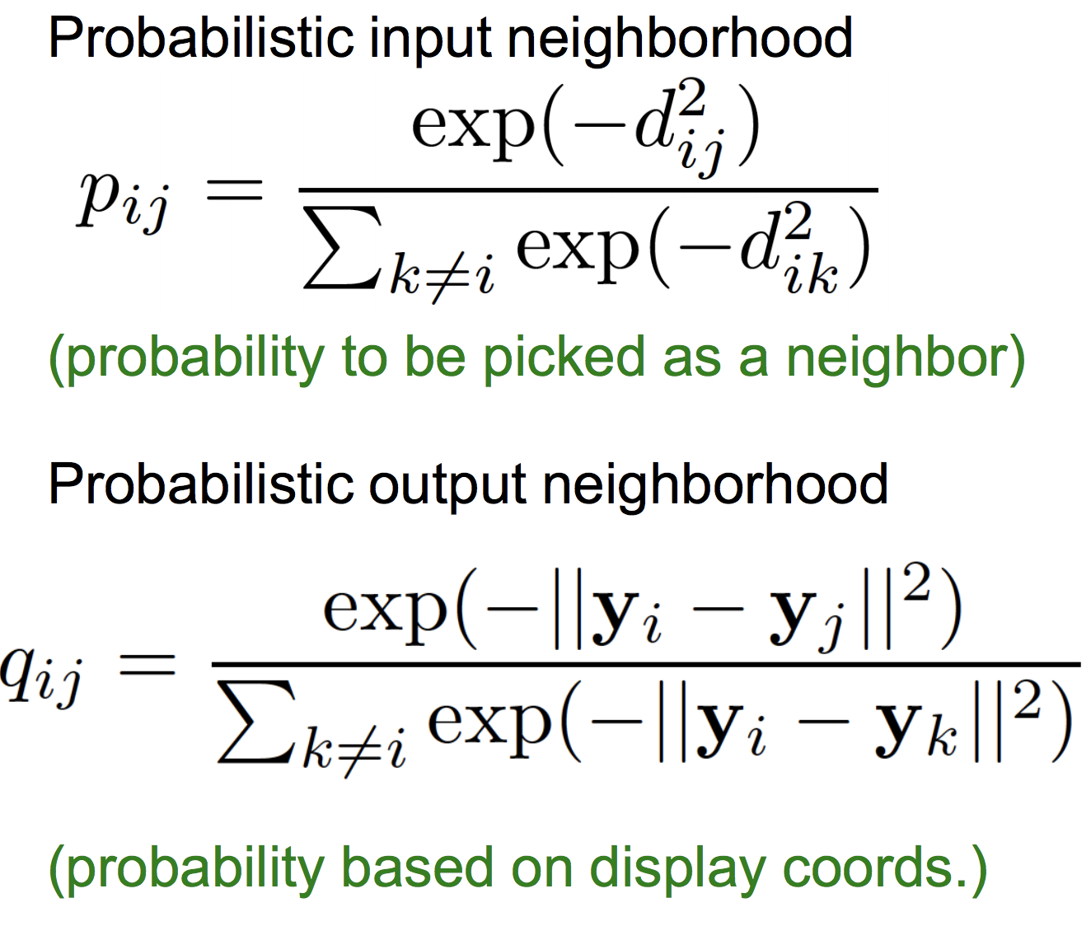

Slide 55
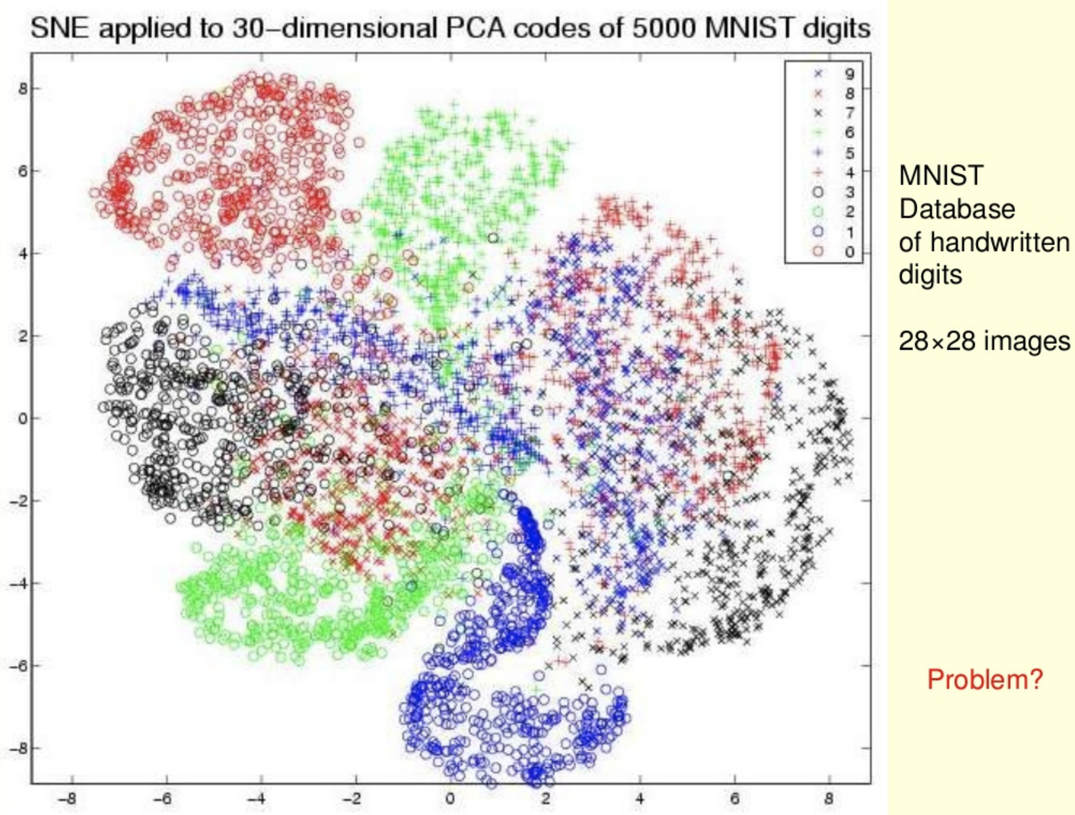

Slide 57
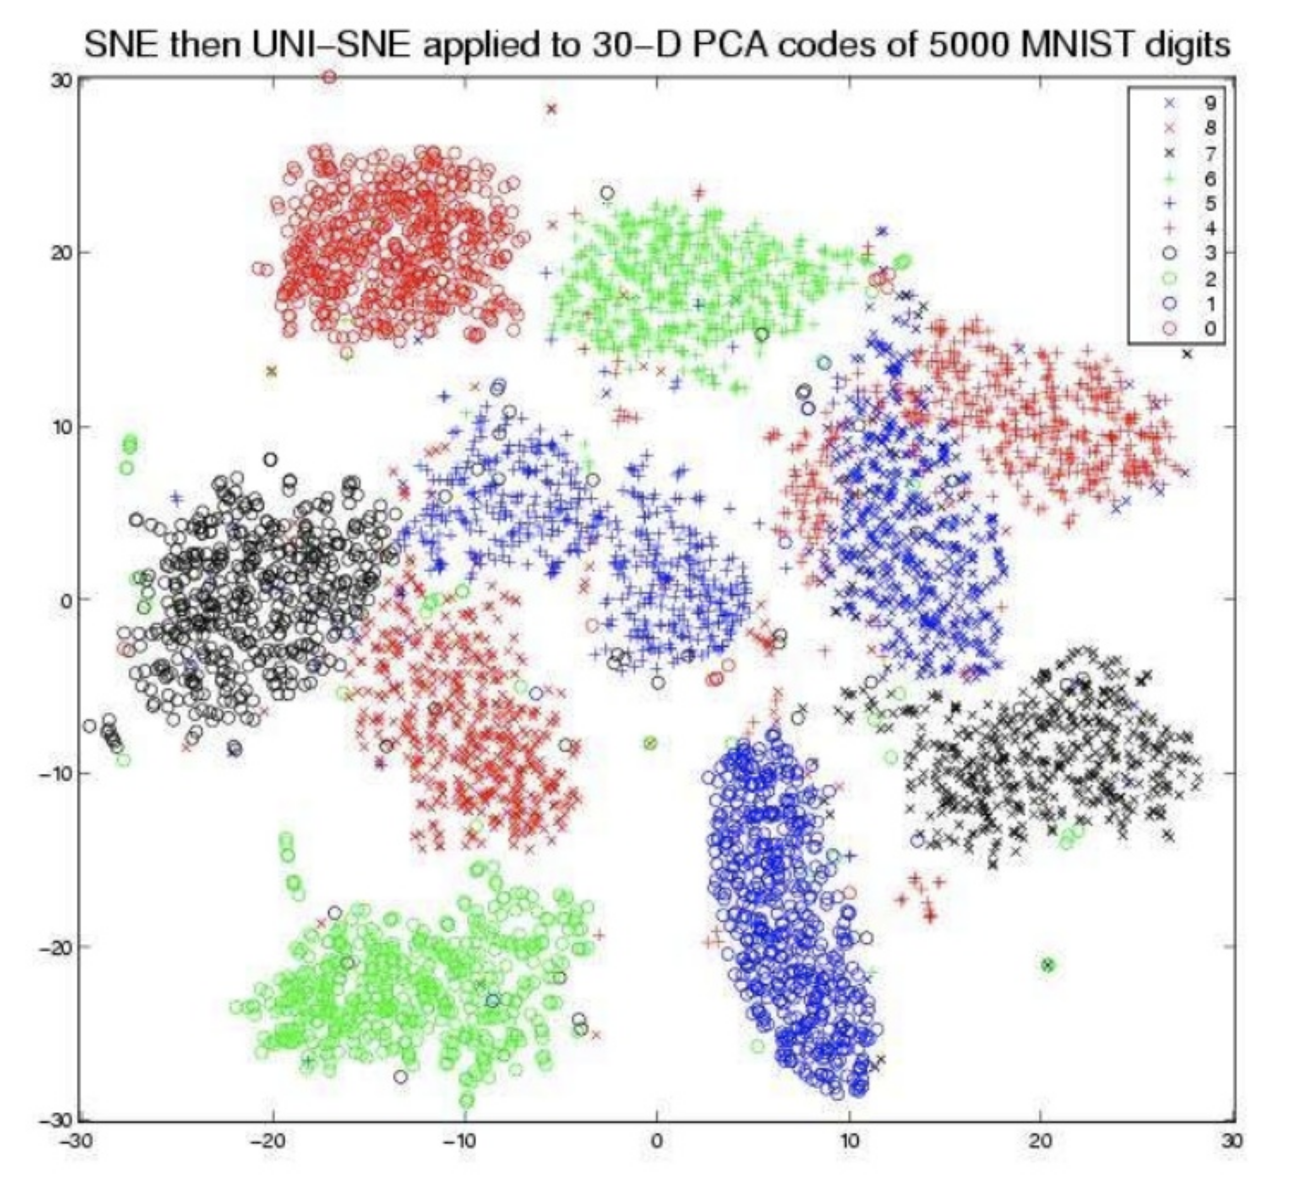

Slide 64
Resources
Analysis of single cell RNA-seq data (Cambridge University, Hemberg Lab)
awesome-single-cell github (list of software resources)
A practical guide to single-cell RNA-sequencing for biomedical research and clinical applications (Haque et al. 2017)
MCB112: Biological Data Analysis, Lecture 06 (Harvard)
simpleSingleCell (step-by-step workflow for low-level analysis of single-cell RNA-seq data with Bioconductor)

